Slide 1
Employee Retention Analysis and Modelling

Slide 2
Introduction
The current employee turnover rate is 16.35%
Using the data we have built a picture of who these people are and how to stop them.
A correlation analysis depicts the the main factors causing people to leave.
From this we can build a profile of a leaver and develop tactical insights into how to retain these employees.
We have developed a machine learning model to predict employees at risk of leaving.

Slide 3
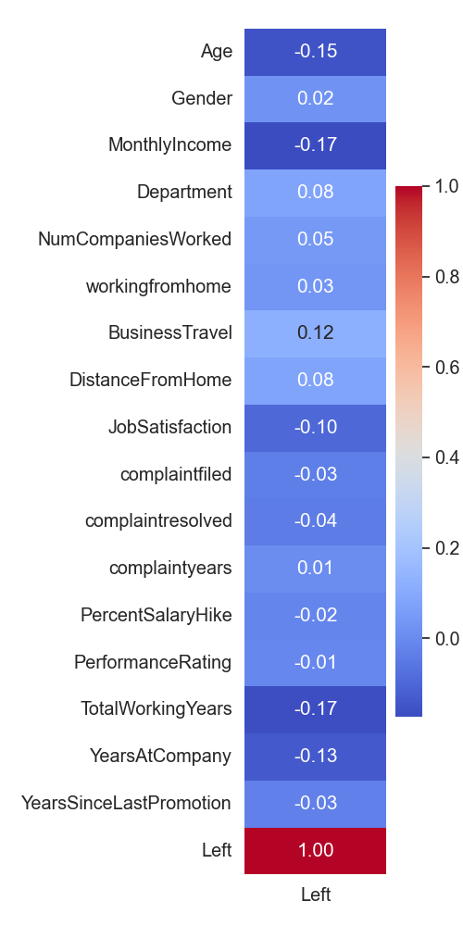
Correlation Analysis
Conducting correlation analysis on the dataset we can see what are the most influential factors are on whether an employee has left or not.
The magnitude of the correlation, negative or positive indicates which categories are the most influential.
From this we can determine what aspects to focus our analysis on.
The lowest scoring categories can then be removed.

Slide 4
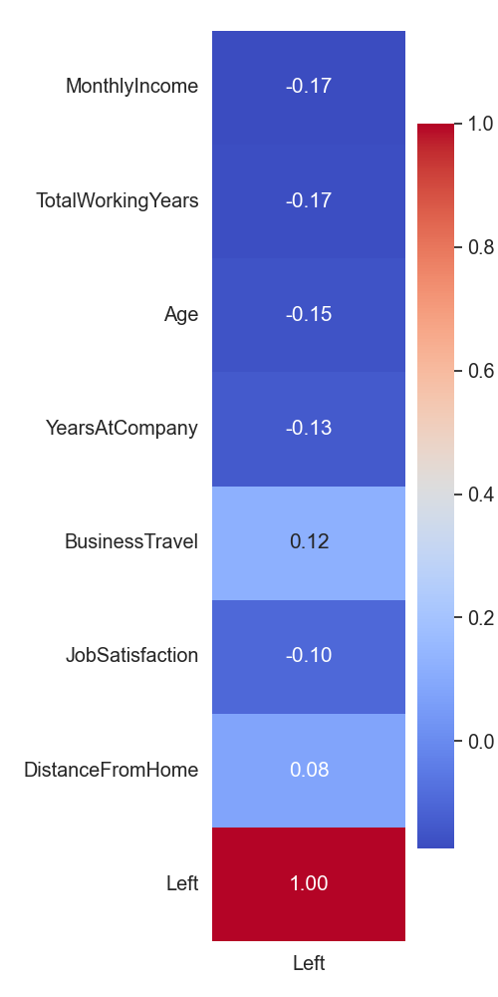
Properties of a Leaver
Low Income
Those on lower income are more likely to leave.
Less experienced
Those who have worked for less time are more likely to leave
Younger
Younger employees are more likely to leave
Newer to company
Those who have worked at the company for less time are more likely to leave.
Travel More
Those who travel are more likely to leave
Low Job Satisfaction
Those with less job satisfaction are more likely to leave
Far From Home
Those that work further from home are more likely to leave

Slide 5
Influential Factors
The 7 most influential factors in order of influence are:
Monthly Income
Total Working Years
Age
Years at Company
Business Travel
Job Satisfaction
Distance from Home
From this we can determine the properties of a leaver

Slide 6
Composition of Leavers Employee Turnover Rate - 16.35%
Salary band
Salary band
Salary band
40% have 0-5 years working experience, these are all in the lowest income band.
35% of have less than 5 years experience and were also on the lowest salary band.
45% have 6-11 years experience
Totalling 85% of the leavers have under 11 years working experience of these 53% are in the lowest income band.
The majority of those that left were therefore under 37 with less than 11 years of working experience and most of these on the lowest salary band
72% of leavers were under the age of 37
Of these 61% were in the lowest salary band.
29% were in the medium salary band

Slide 7
Monthly Income & Salary Hike
Left
Left
53% of those that left were in the low income band.
64% of those that left received the lowest salary hike of 11-15%
Those that received the moderate salary hike of 16-20% left at half the rate.
This suggests that financial incentive was a common reason for leaving.
% Salary Hike
27% of company’s workforce in the low salary band left.
The medium and high bands had a retention rate of 88.4% and 89.3% respectively.
This amounts to an 8% loss of the company employees.

Slide 8
Income, Experience and Age
Salary band
Age group
46% of the leavers were aged 28-37 and of these nearly half were in the low income bracket.
25% of the leavers were aged 18-27 and almost all of these were in the low income bracket.
Together this accounts for 66% of those that left
We can pool these into two target age groups, 18-27 and 28-37.
48% had a total working experience of less than 5 years most of these were under 27
43% had a total working experience of 6-11 years these were aged mostly in the 27-37 bracket.
Together this accounts for 91% of the leavers with a total working experience of less than 11 years
We can pool these into our two age groups of 18-27 year olds with less than 5 years work experience and 28-37 year olds with 6-11 years working experience.

Slide 9
Target Demographics
1st Priority – 46.8% of leavers.
Aged 28-37
6-11 years of working
Low income and medium incomes
Lower Pay hike
Solutions
Require increased financial incentive at this stage.
Offer medium salary at age 28 or pay hike if the employee has been working for 6 years.
Readjust low and medium pay hike structure to focus around 15-16%
Outcome
Will retain more experienced staff.
Will lose less staff that could be integral to the company
2nd Priority Demographic
Under 27
Low income
Lower Pay Hike
0-5 years of working
Solutions
Offer increased training packages and ad-hoc financial incentives such as bonuses.
Offer room for career progression or sideways movement for career changes.
Readjust the salary hike structure to focus around the high end of the low band and the low end of the moderate band at 15-16%.
Outcome
Will retain those that wish to invest in career and will be future integral employees.
Will retain those that want a change of role.

Slide 10
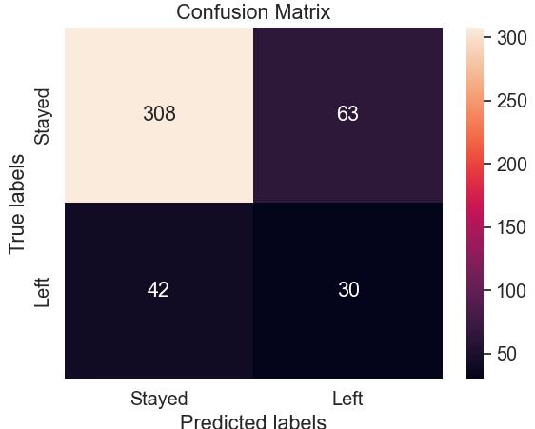
Prediction Model
A ‘Decision Tree’ machine learning model was trained on the data to predict potential future leavers.
The model was built using the following categories for predicting:
Monthly Income
Total Working Years
Age
Years at Company
Business Travel
Job Satisfaction
Distance from Home
The model was trained on ¾ of the data and then tested on ¼ of the data (443 employees) it had not seen before.
The model correctly predicted 308 of the employees that stayed and 30 of the 72 that left.
Whilst it incorrectly predicted 42 that left would stay.
It has predicted a further 63 employees in this sampled of 443 that may leave. The details of these can be provided, and the model used for future employees.

Slide 11
Conclusion
By targeting these demographics overall employee turnover rate can potentially be reduced from 16.35% to 10.85% retaining the employees with the greater experience and career ambition.
The prediction model can be used to target individuals who have a high risk of leaving before they do.

